Slide 1
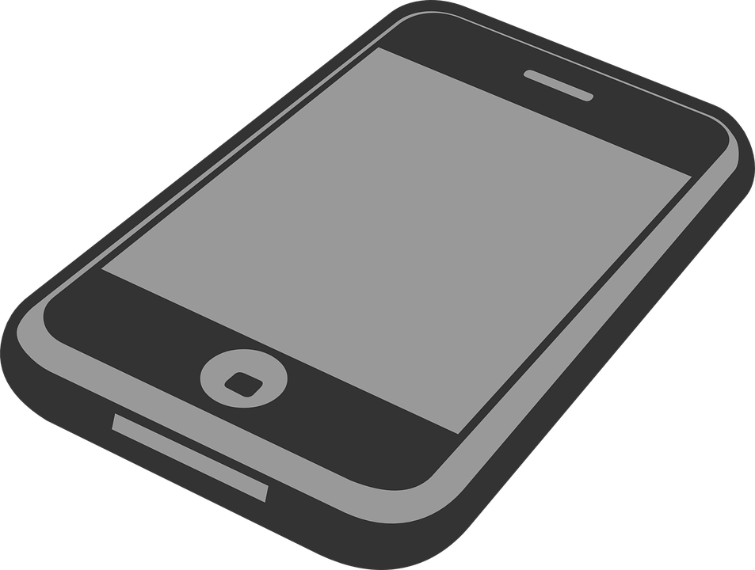
Impact of Mobile PHONE Usage on Students' Health and academic performance
Project Group 16

Slide 2
Group Details
Group Number: 16
Team Members:
Goda Kodati
Ganesh Vasa
Mohan Vamsi Sajja
Manohar Reddy Thirumalareddy
Sri Hari Shankar Reddy Mandapati

Slide 3
Objective
Our project aims to assess the impact of mobile phone usage on students' mental and physical health, and academic performance, using survey data from a diverse student population. We employ advanced statistical and machine learning techniques to identify the consequences and benefits associated with varying mobile usage patterns. The goal is to offer actionable recommendations for optimizing mobile habits to enhance student well-being and educational effectiveness. Through innovative data integration and analysis, we aim to generate insights that can guide future educational policies and health interventions.

Slide 4
Data Overview
Dataset: Impact_of_Mobile_Phone_on_Students_Health.csv
Source: Kaggle
Contains data on daily usage, health impacts, and performance impacts.
Responses on mobile usage impact are detailed and standardized (e.g., strongly agree, neutral), enhancing the precision of analysis.
Unique Aspects:
The survey specifically asks about various dimensions of students' lives that could be impacted by mobile phone use, such as sleep patterns, mental health, and study habits, allowing for a multi-dimensional impact analysis.
The dataset offers insights into the behavioral aspects of mobile usage, such as the contexts in which phones are used (e.g., during study, before sleep), providing a deeper understanding of usage patterns.

Slide 5
Data Cleaning and Preparation
Standardization and Consistency
Categorical Responses: Unified terms like 'agree' to 'Agree' across all survey responses to ensure consistency.
Missing Data Management
Imputation: Applied simple imputation techniques to address missing values, maintaining dataset integrity while acknowledging potential bias.
Quality Assurance
Validation: Conducted data integrity checks to ensure correct labeling and consistency post-cleanup.
Preparation for Analysis: Transformed and split the dataset for machine learning analysis using PyCaret, optimizing it for training and testing.
☞ We did not create any new features but just cleaned and prepared existing data

Slide 6
Model Selection, Evaluation, and Results
Model Selection
Used PyCaret for streamlined model testing.
Models: SVM, Logistic Regression, Random Forest.
Evaluation
Metric: Focused on accuracy.
Best Model: SVM (accuracy: 33.57%).
Observations
Insight: Moderate accuracy indicates the need for better features.
Future Direction: Improve feature engineering and expand evaluation metrics.
Clustering Analysis
Utilized K-Means clustering to identify distinct patterns in student behavior regarding mobile usage. The analysis revealed five optimal clusters, providing a detailed segmentation that can inform targeted educational interventions based on specific usage patterns.

Slide 7
Challenges Faced and Solutions
Data Standardization Problem: Challenging uniform data interpretation across the dataset.
Solution: Automated scripts to standardize response terms, ensuring consistent data handling.
Model Selection and Performance Problem: Low accuracy (33.57% from SVM), difficulty in capturing complex patterns.
Solution: Used PyCaret for efficient model comparison and parameter tweaking to enhance model fit.

Slide 8
Continues….
Handling Missing Data Problem: Simple imputation potentially introduced biases due to non-random missing data.
Solution: Implemented simple imputation while considering further sensitivity analysis to assess the impact on model accuracy.
Tool Limitations Problem: Limited customization in PyCaret constrained model tuning and deeper insights.
Solution: Integrated PyCaret with custom Python code for more granular control over data preprocessing and model adjustments.

Slide 9
Conclusion
Our analysis revealed that mobile phone usage significantly impacts student health and academic performance, with varying effects based on usage patterns. The best-performing SVM model highlighted the need for more comprehensive features, achieving only 33.57% accuracy. Clustering analysis identified five distinct behavioral categories, providing a basis for targeted interventions. These insights suggest the necessity for educational policies and awareness programs tailored to mitigate negative impacts and promote healthy mobile usage. The project also enhanced our team's skills in data analysis and machine learning, underscoring the importance of understanding tool limitations and data intricacies for effective application in educational strategies.

Slide 10
Future Enhancements
Advanced Feature Engineering: Explore adding temporal and behavioral features such as usage timing and context-specific behaviors to better capture the nuanced effects of mobile phone usage on health and academic performance.
Comprehensive Model Evaluation: Implement a range of performance metrics including AUC, precision, recall, and F1-score, along with stratified cross-validation, to enhance model evaluation and address the class imbalances seen in your dataset.

Slide 11
Thank You

